Slide 1

T2A2 MARKET PLACE BOTANIC MARKET
Chen Zhang

Slide 2
Purpose
Local Free Market
Sell and Buy plants , pots and accessories.

Slide 3
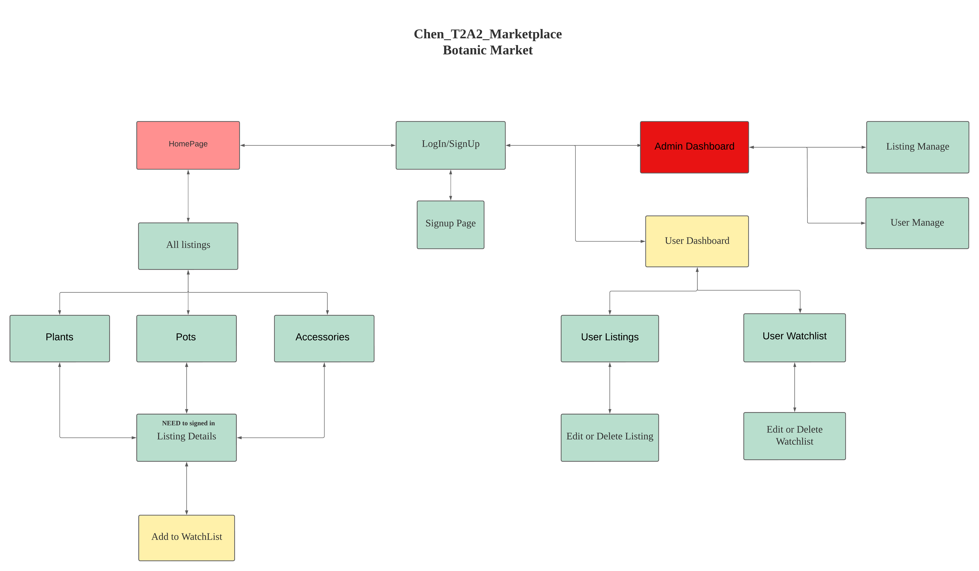

Slide 4
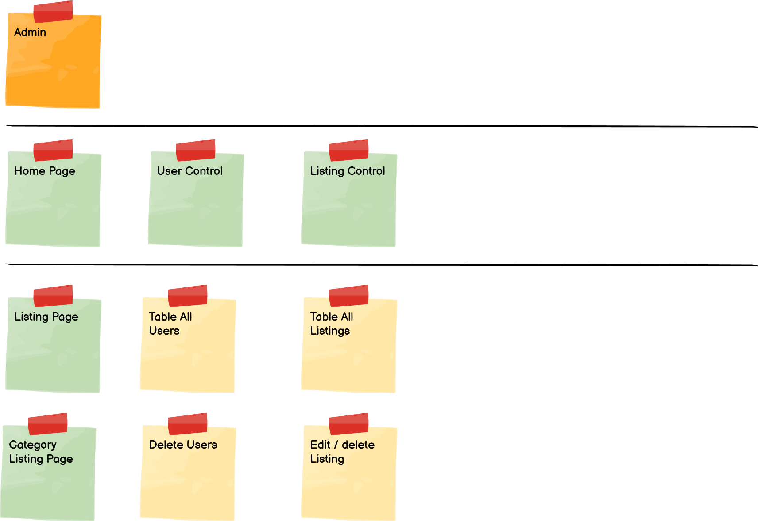
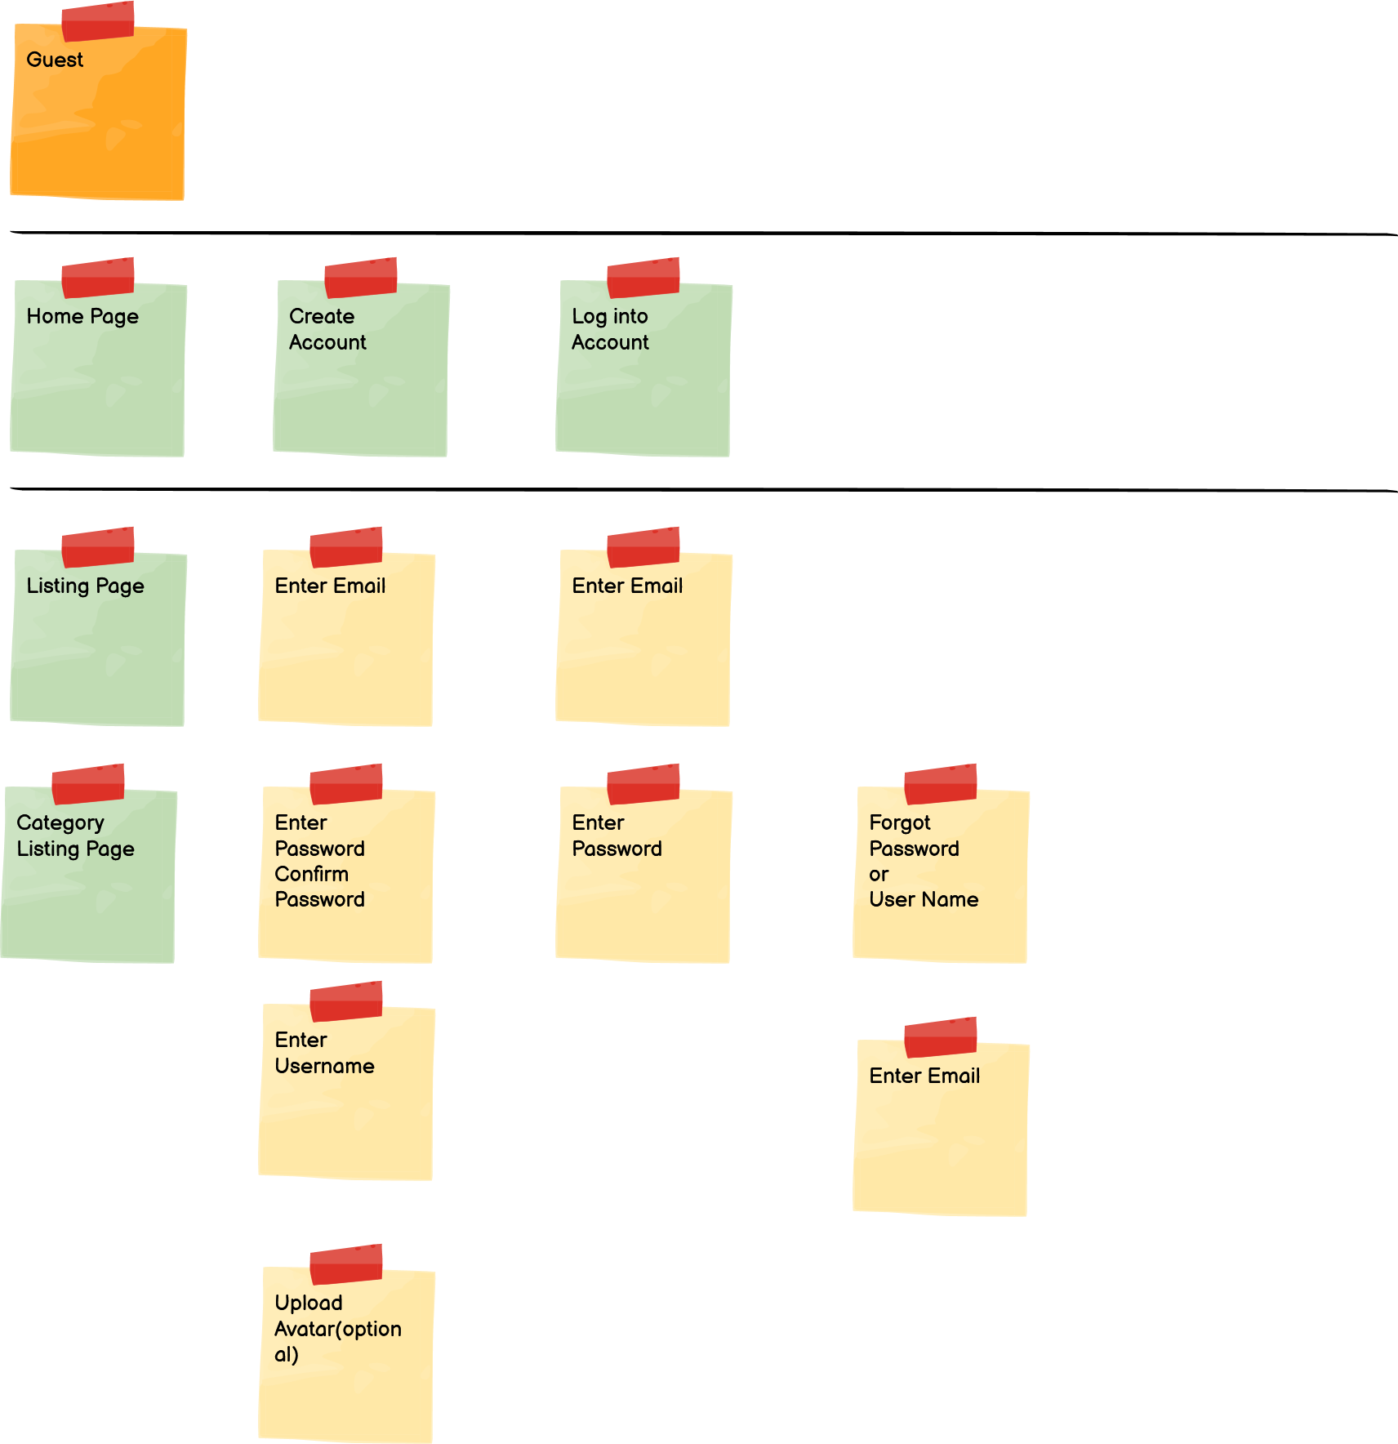

Slide 5
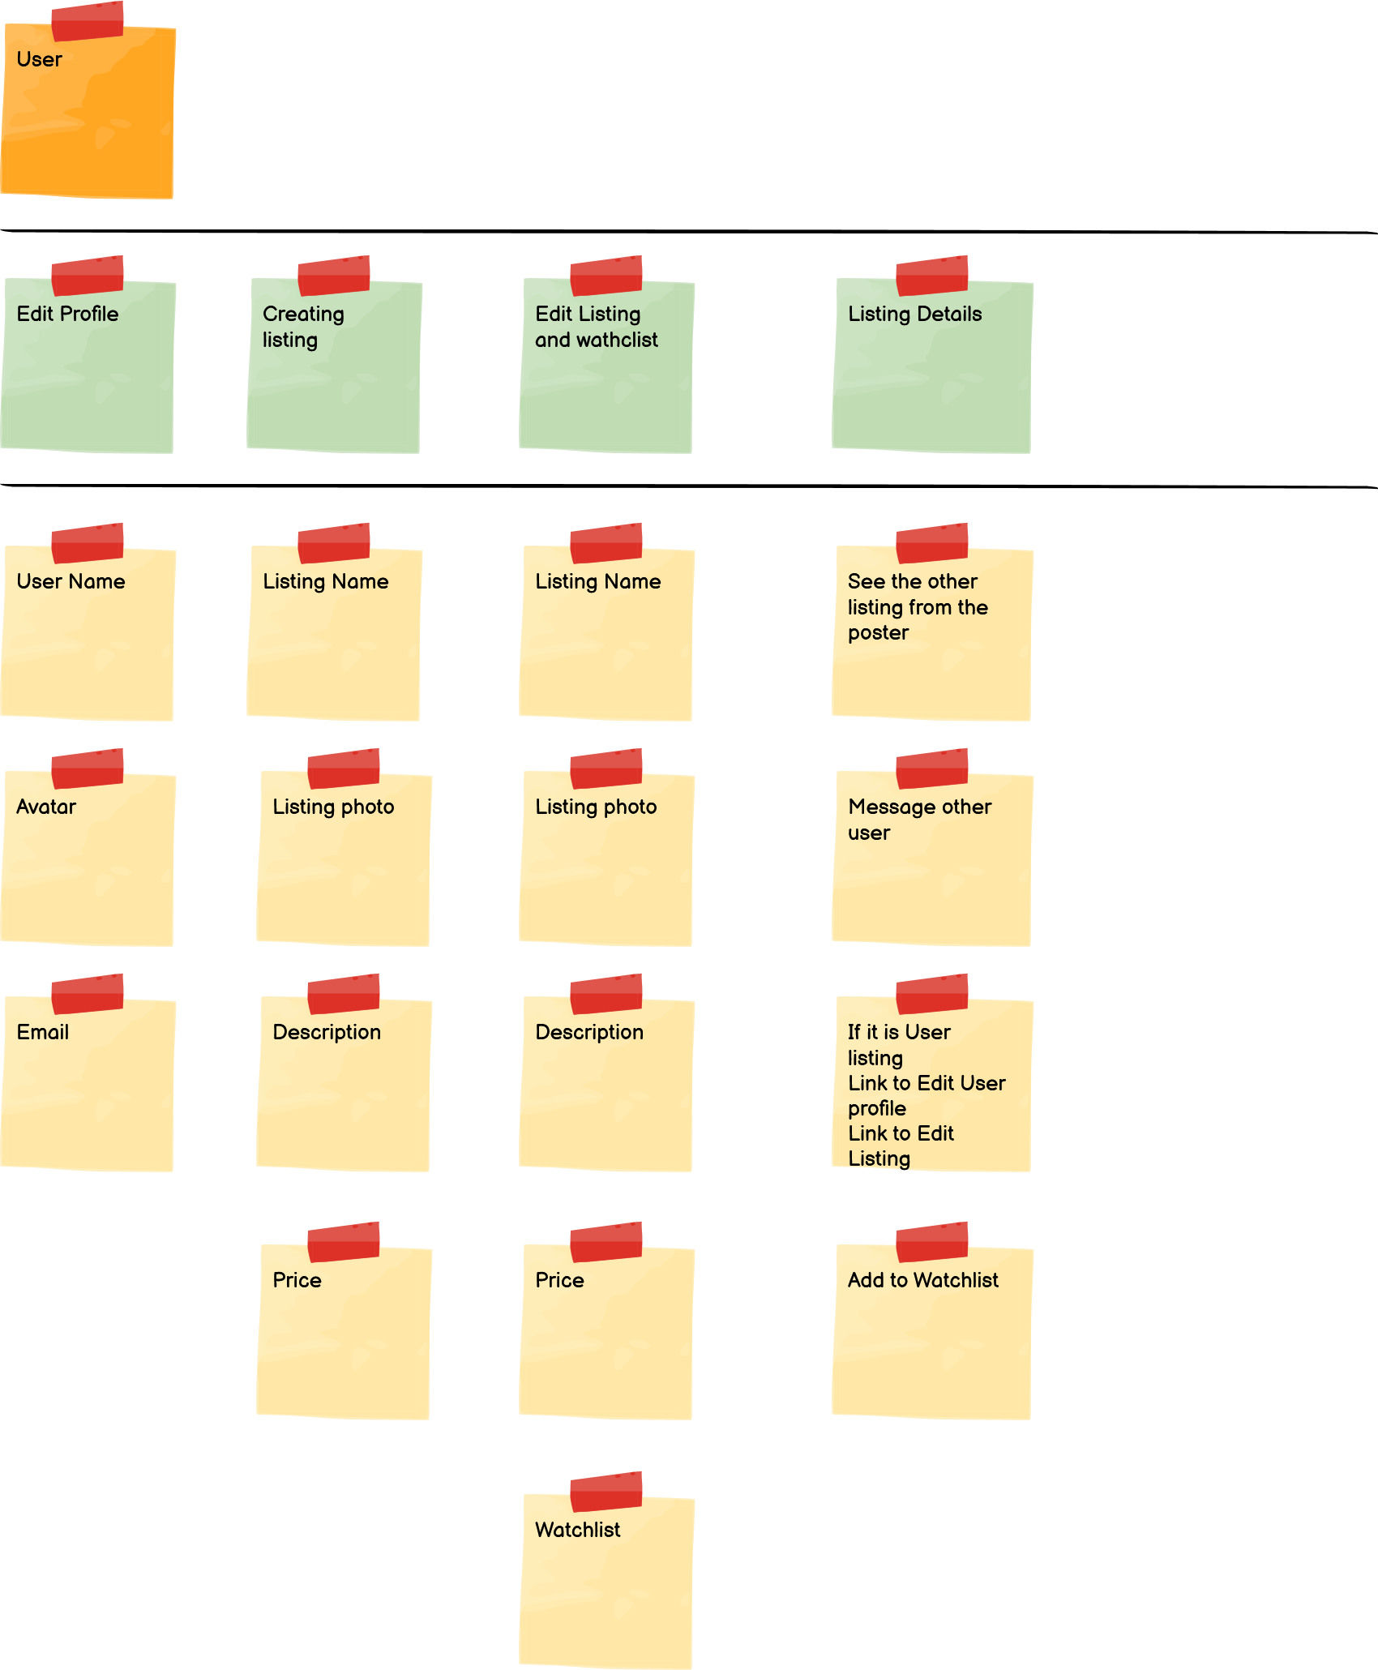

Slide 6
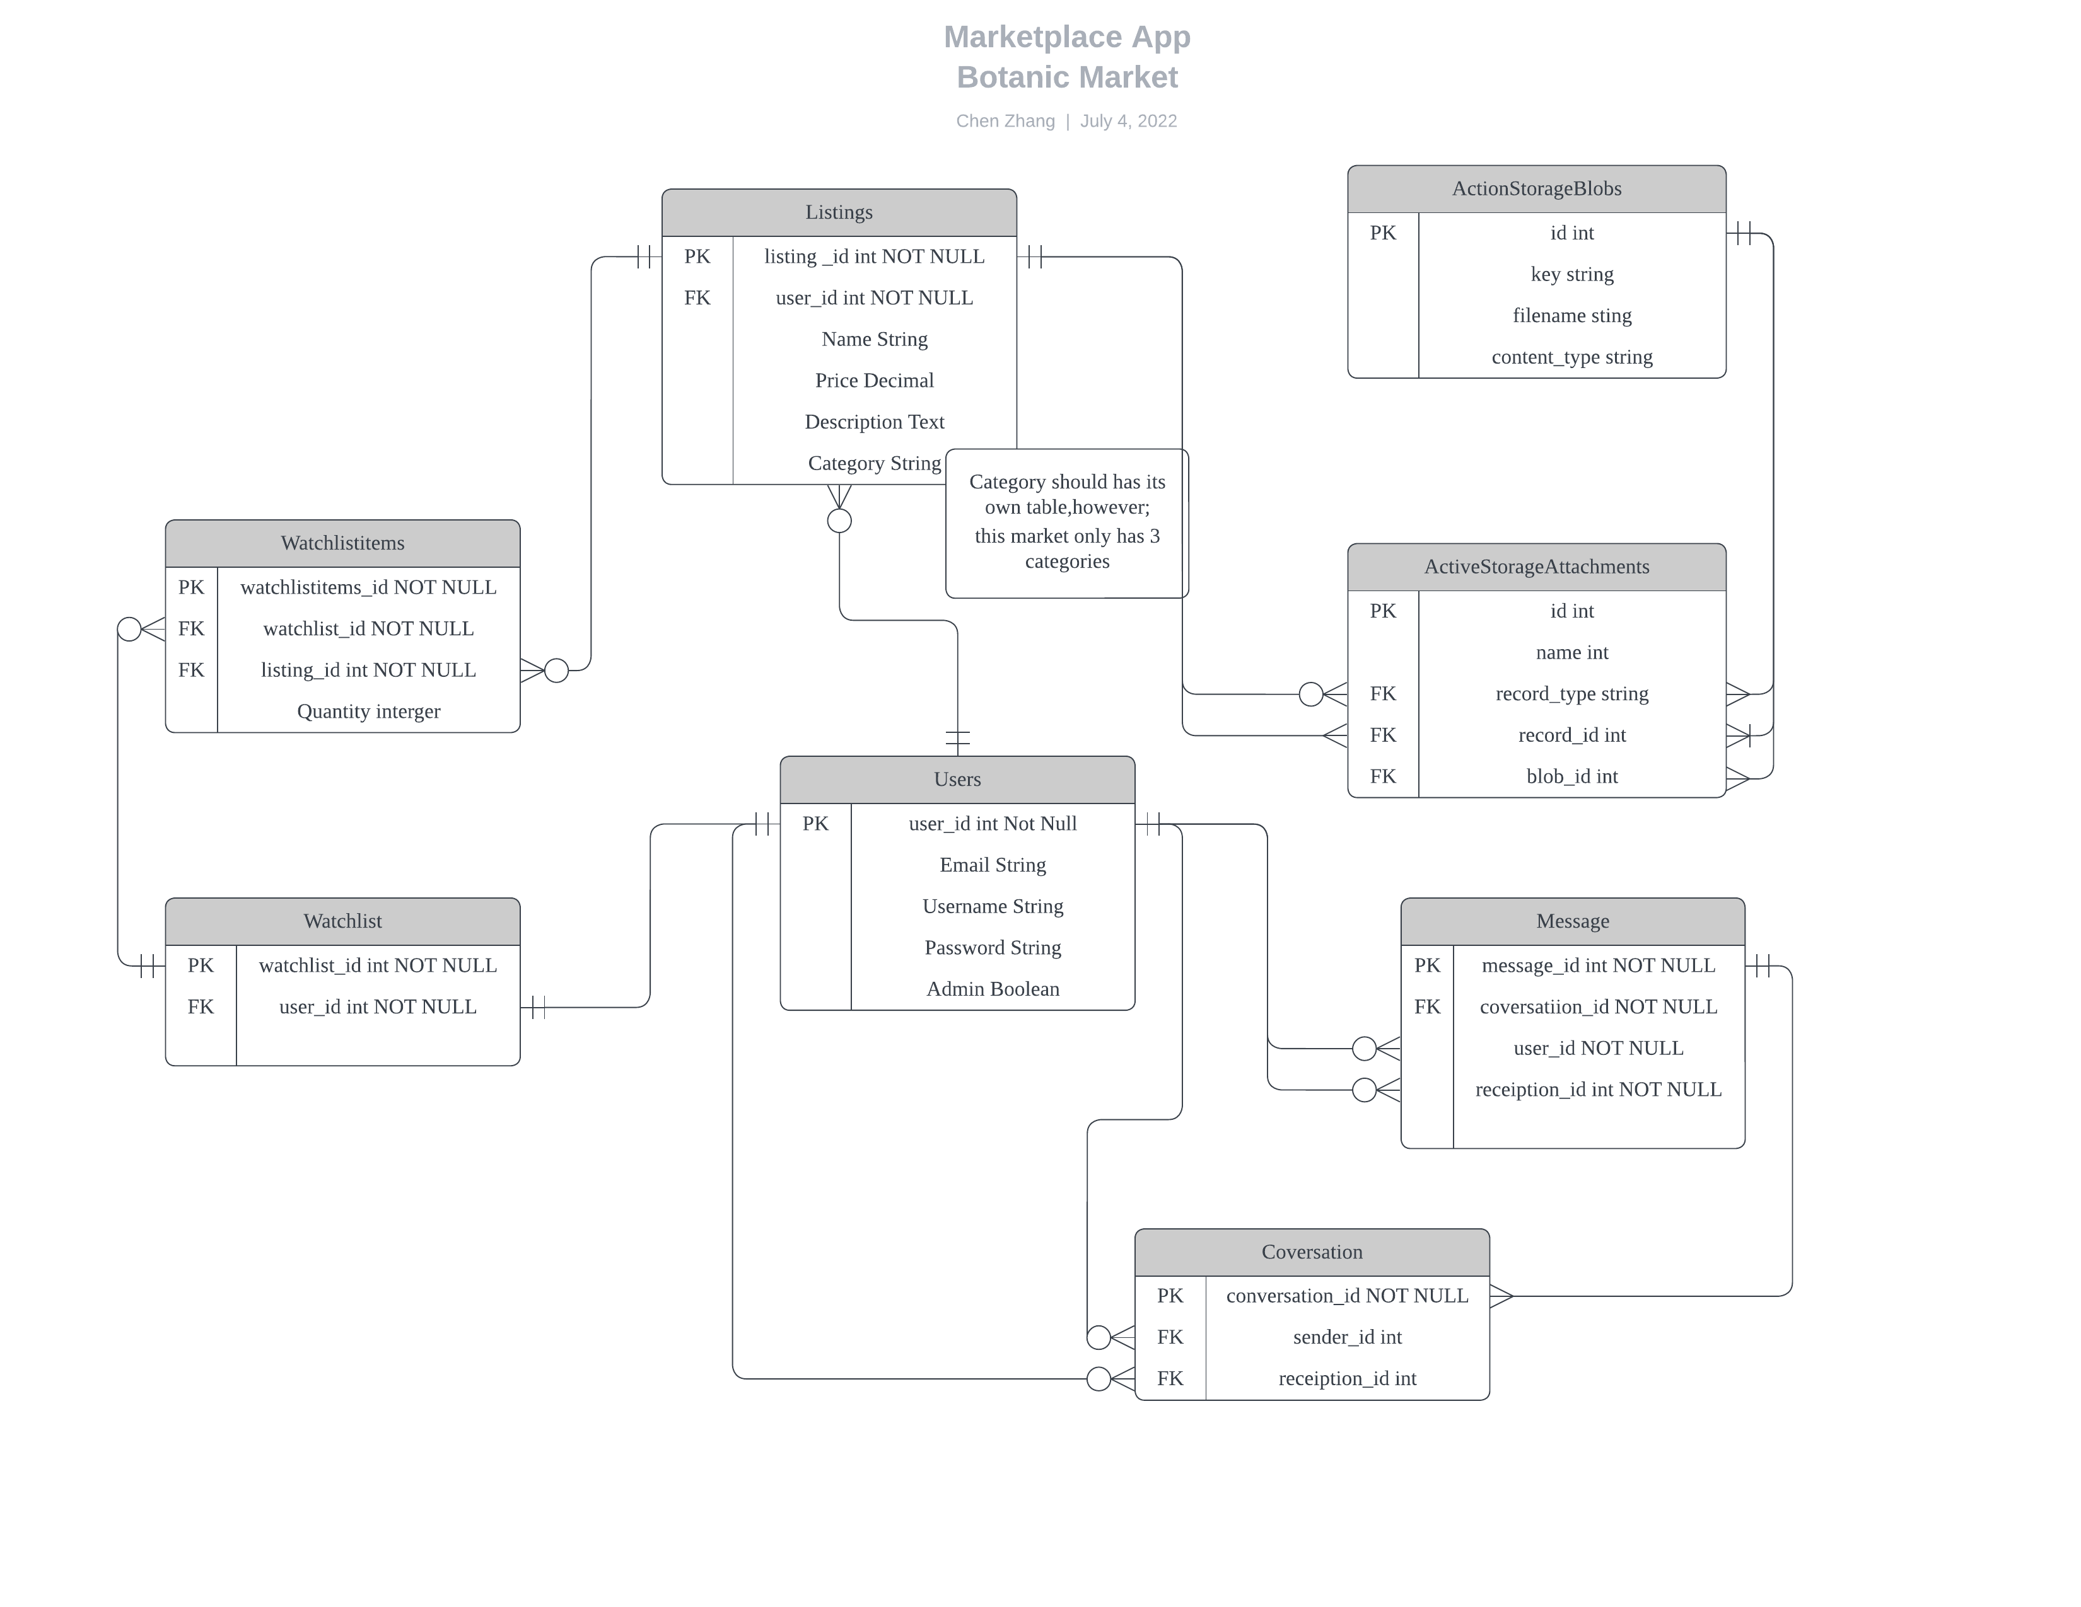
ERD

Slide 7
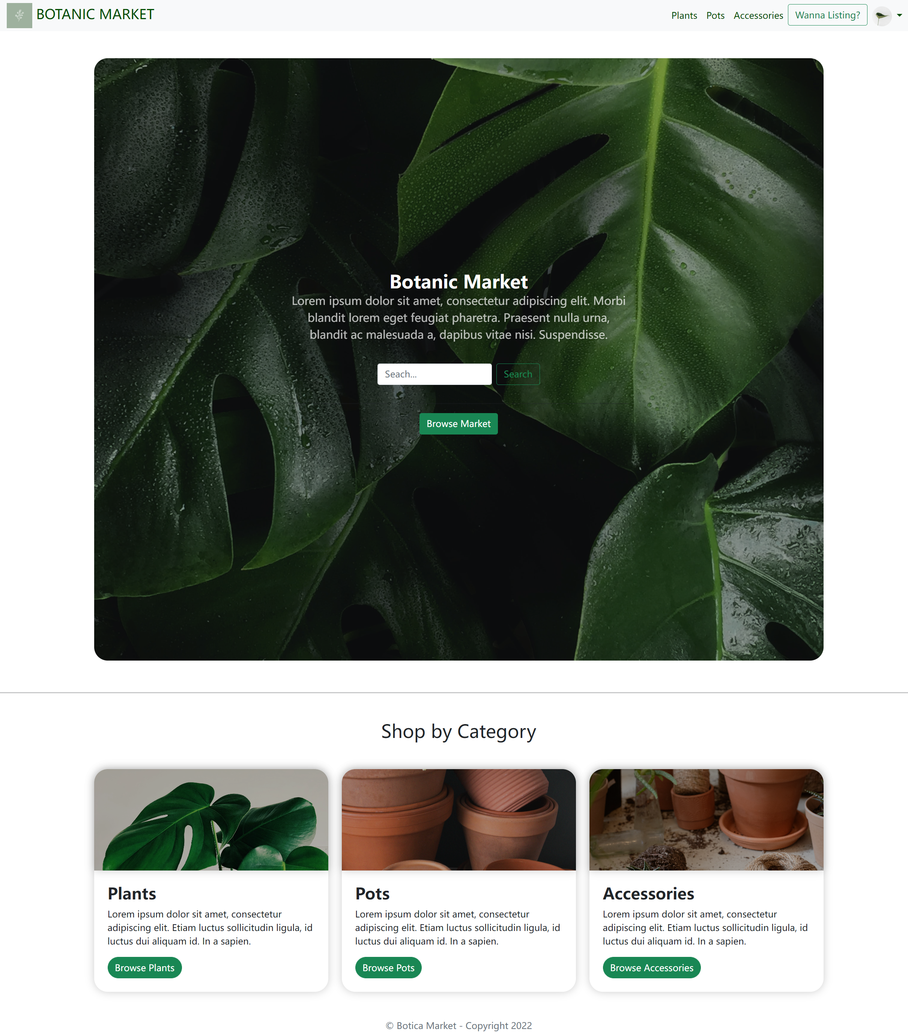
Screen Shot
Home Page

Slide 8
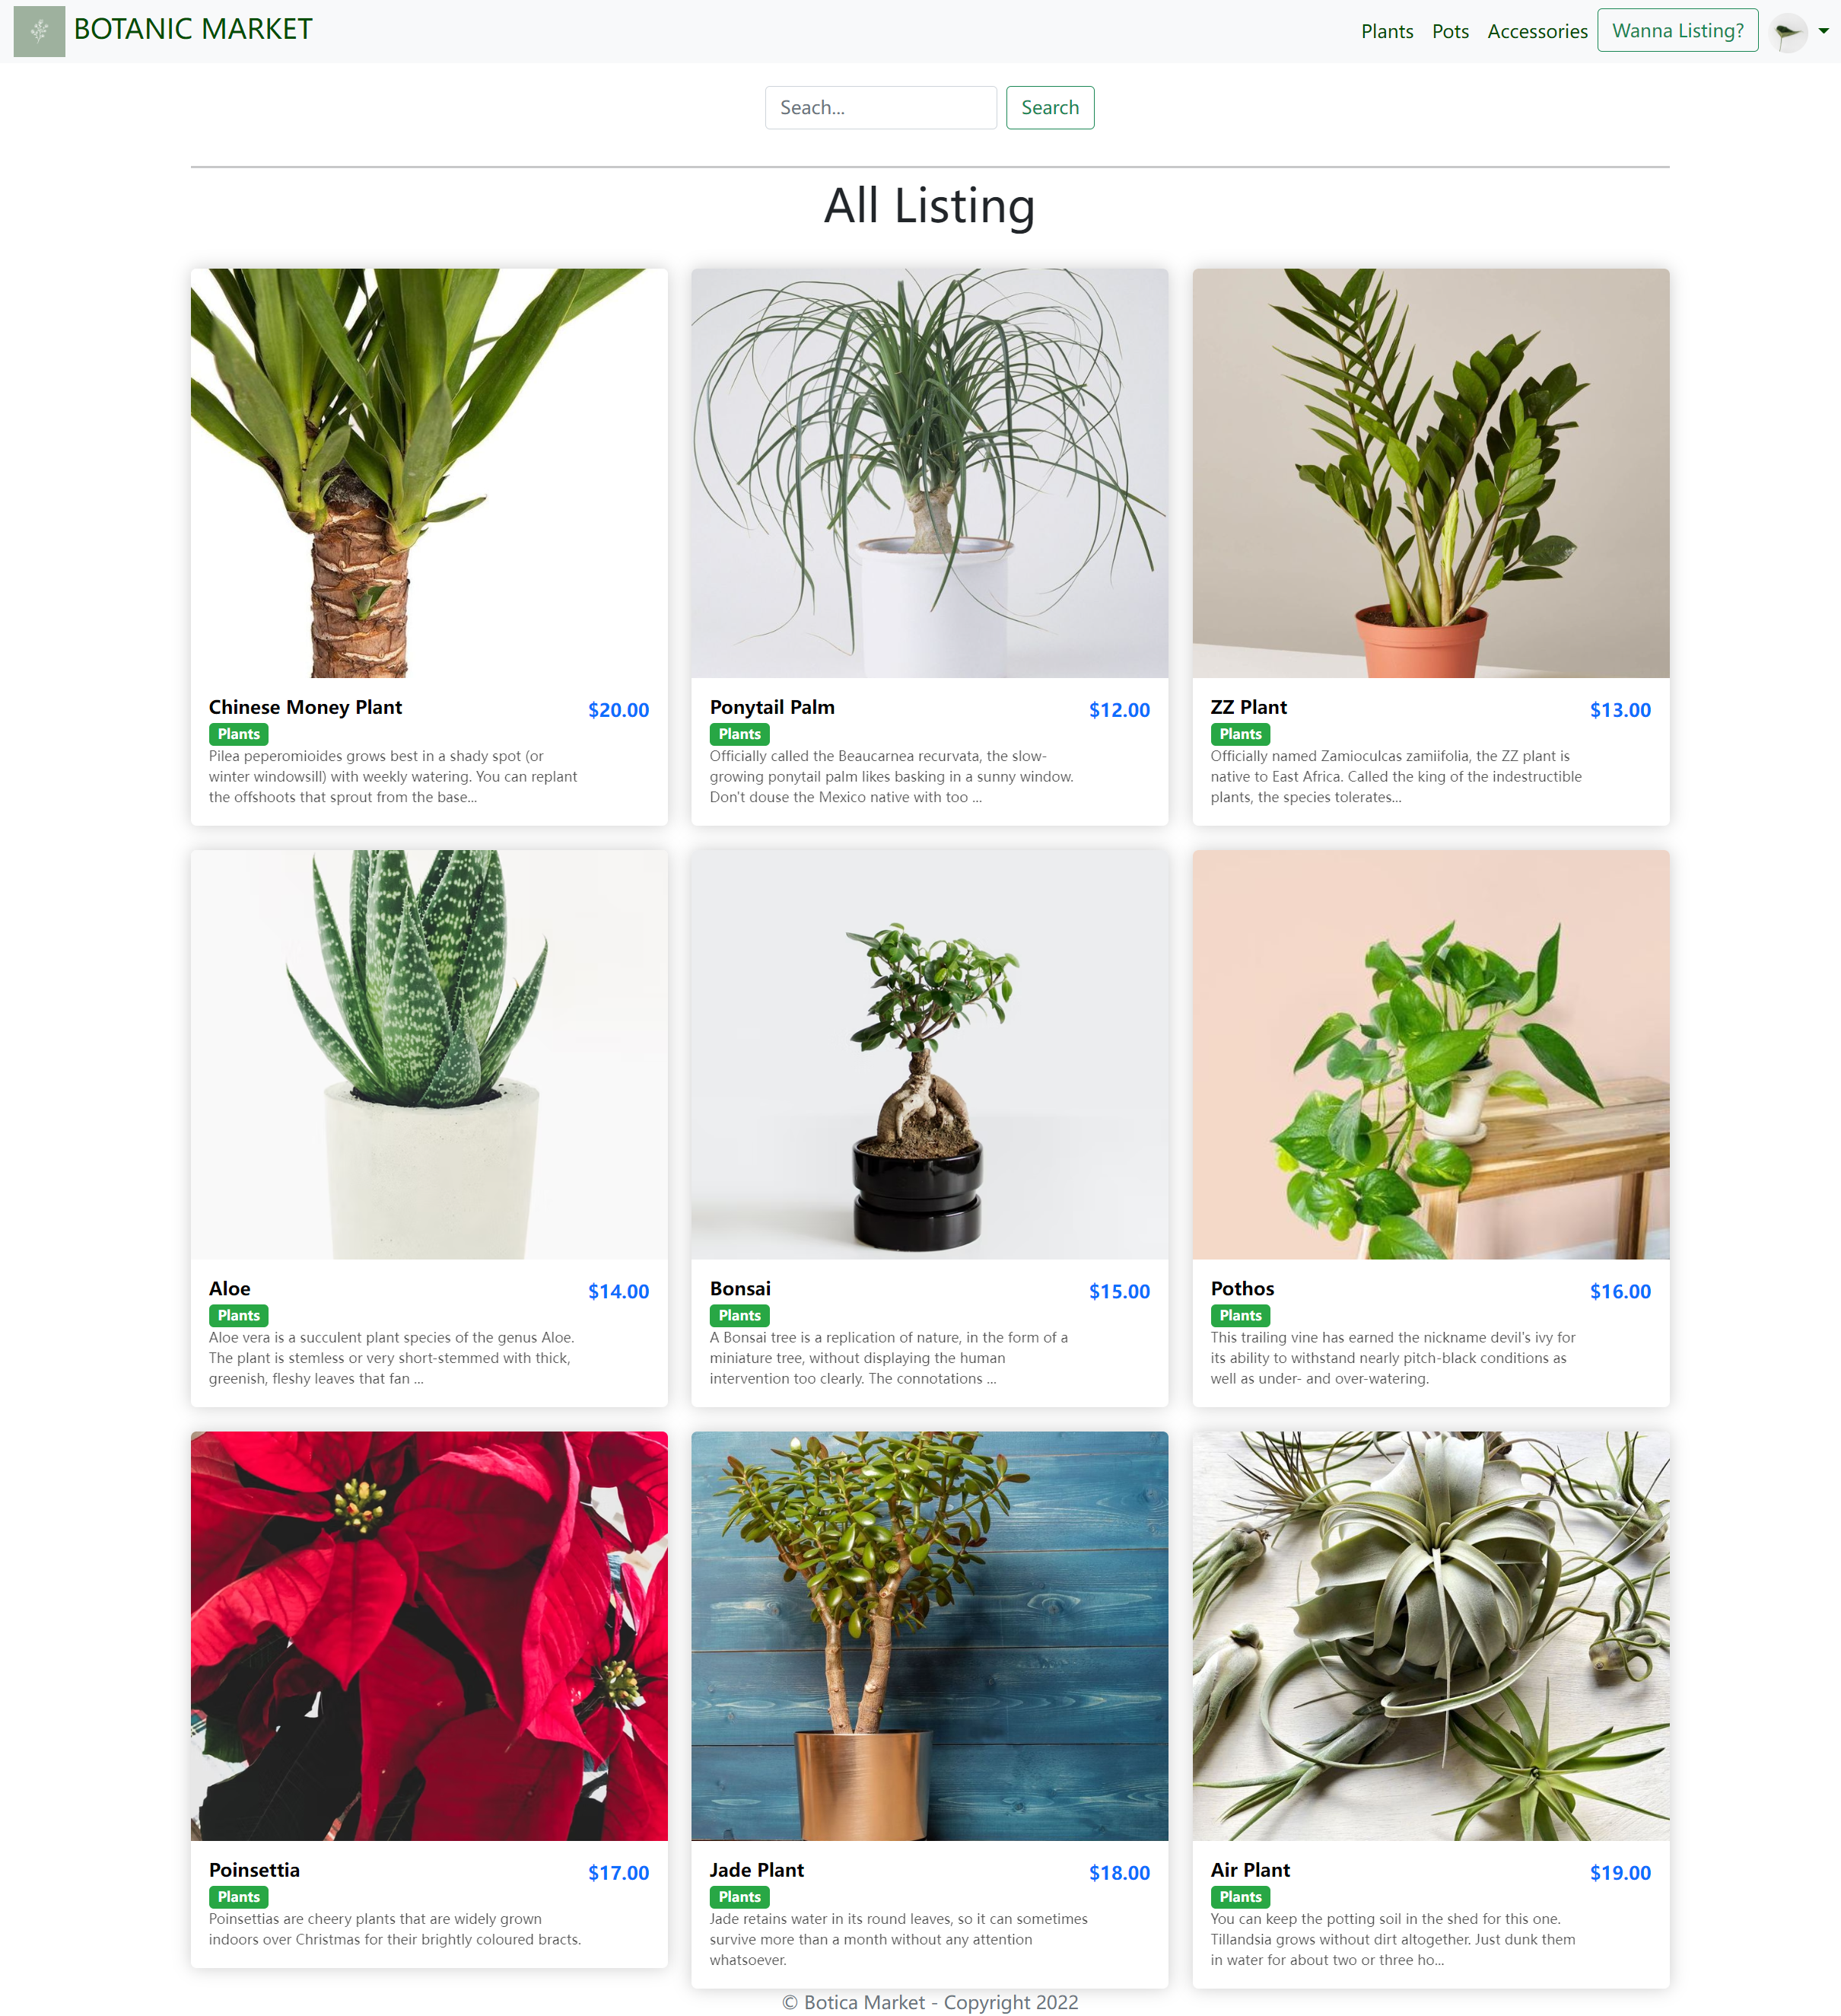
Listing Page

Slide 9
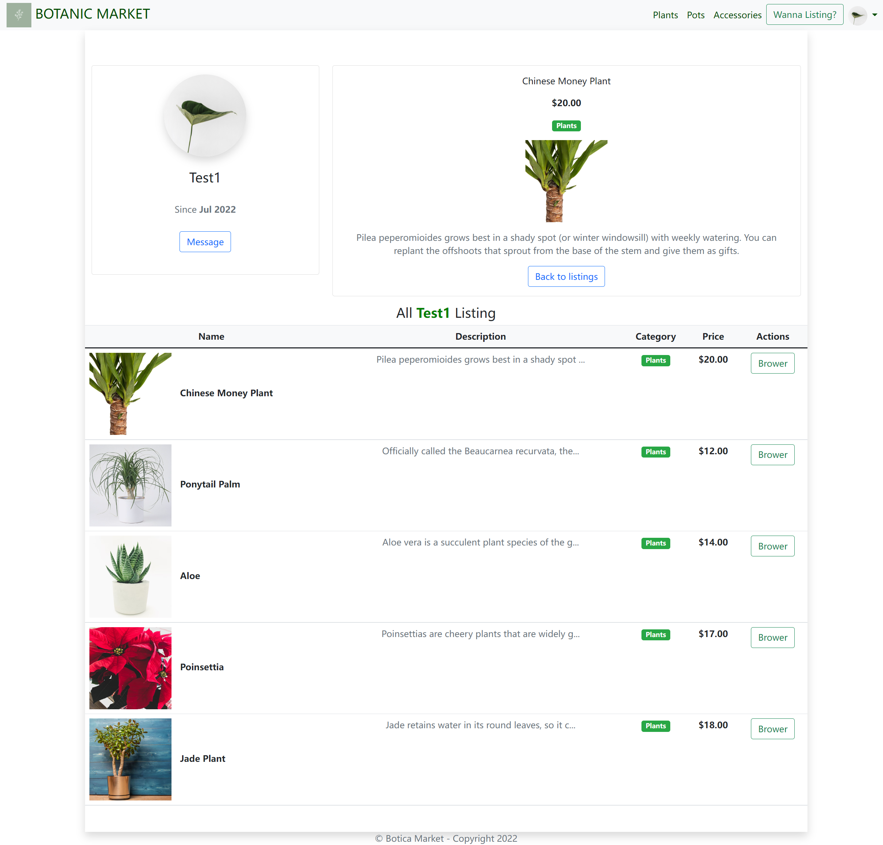
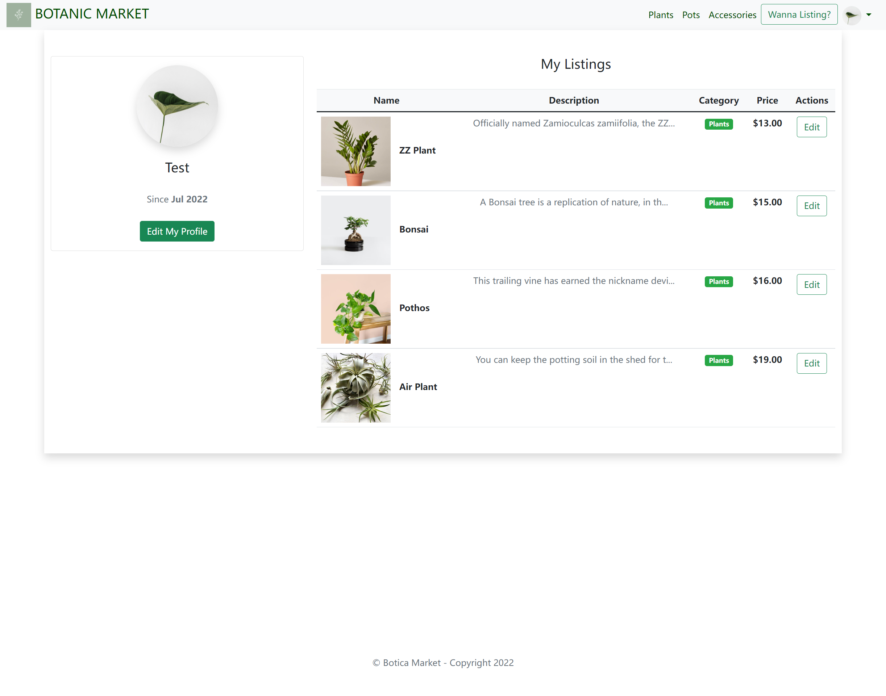
Listing Detail & User Profile

Slide 10
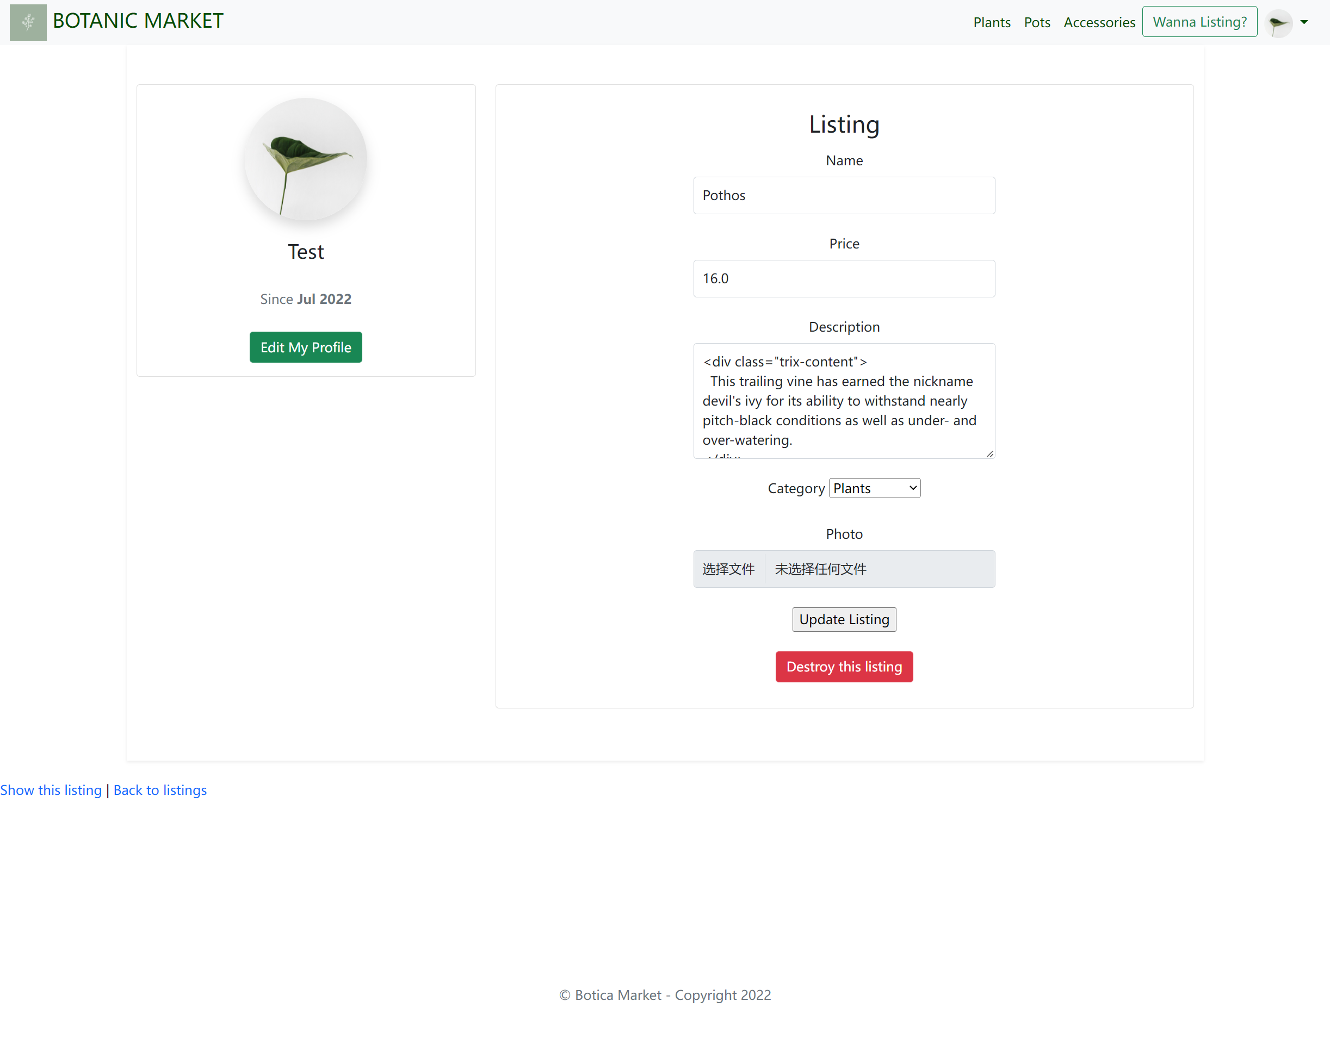
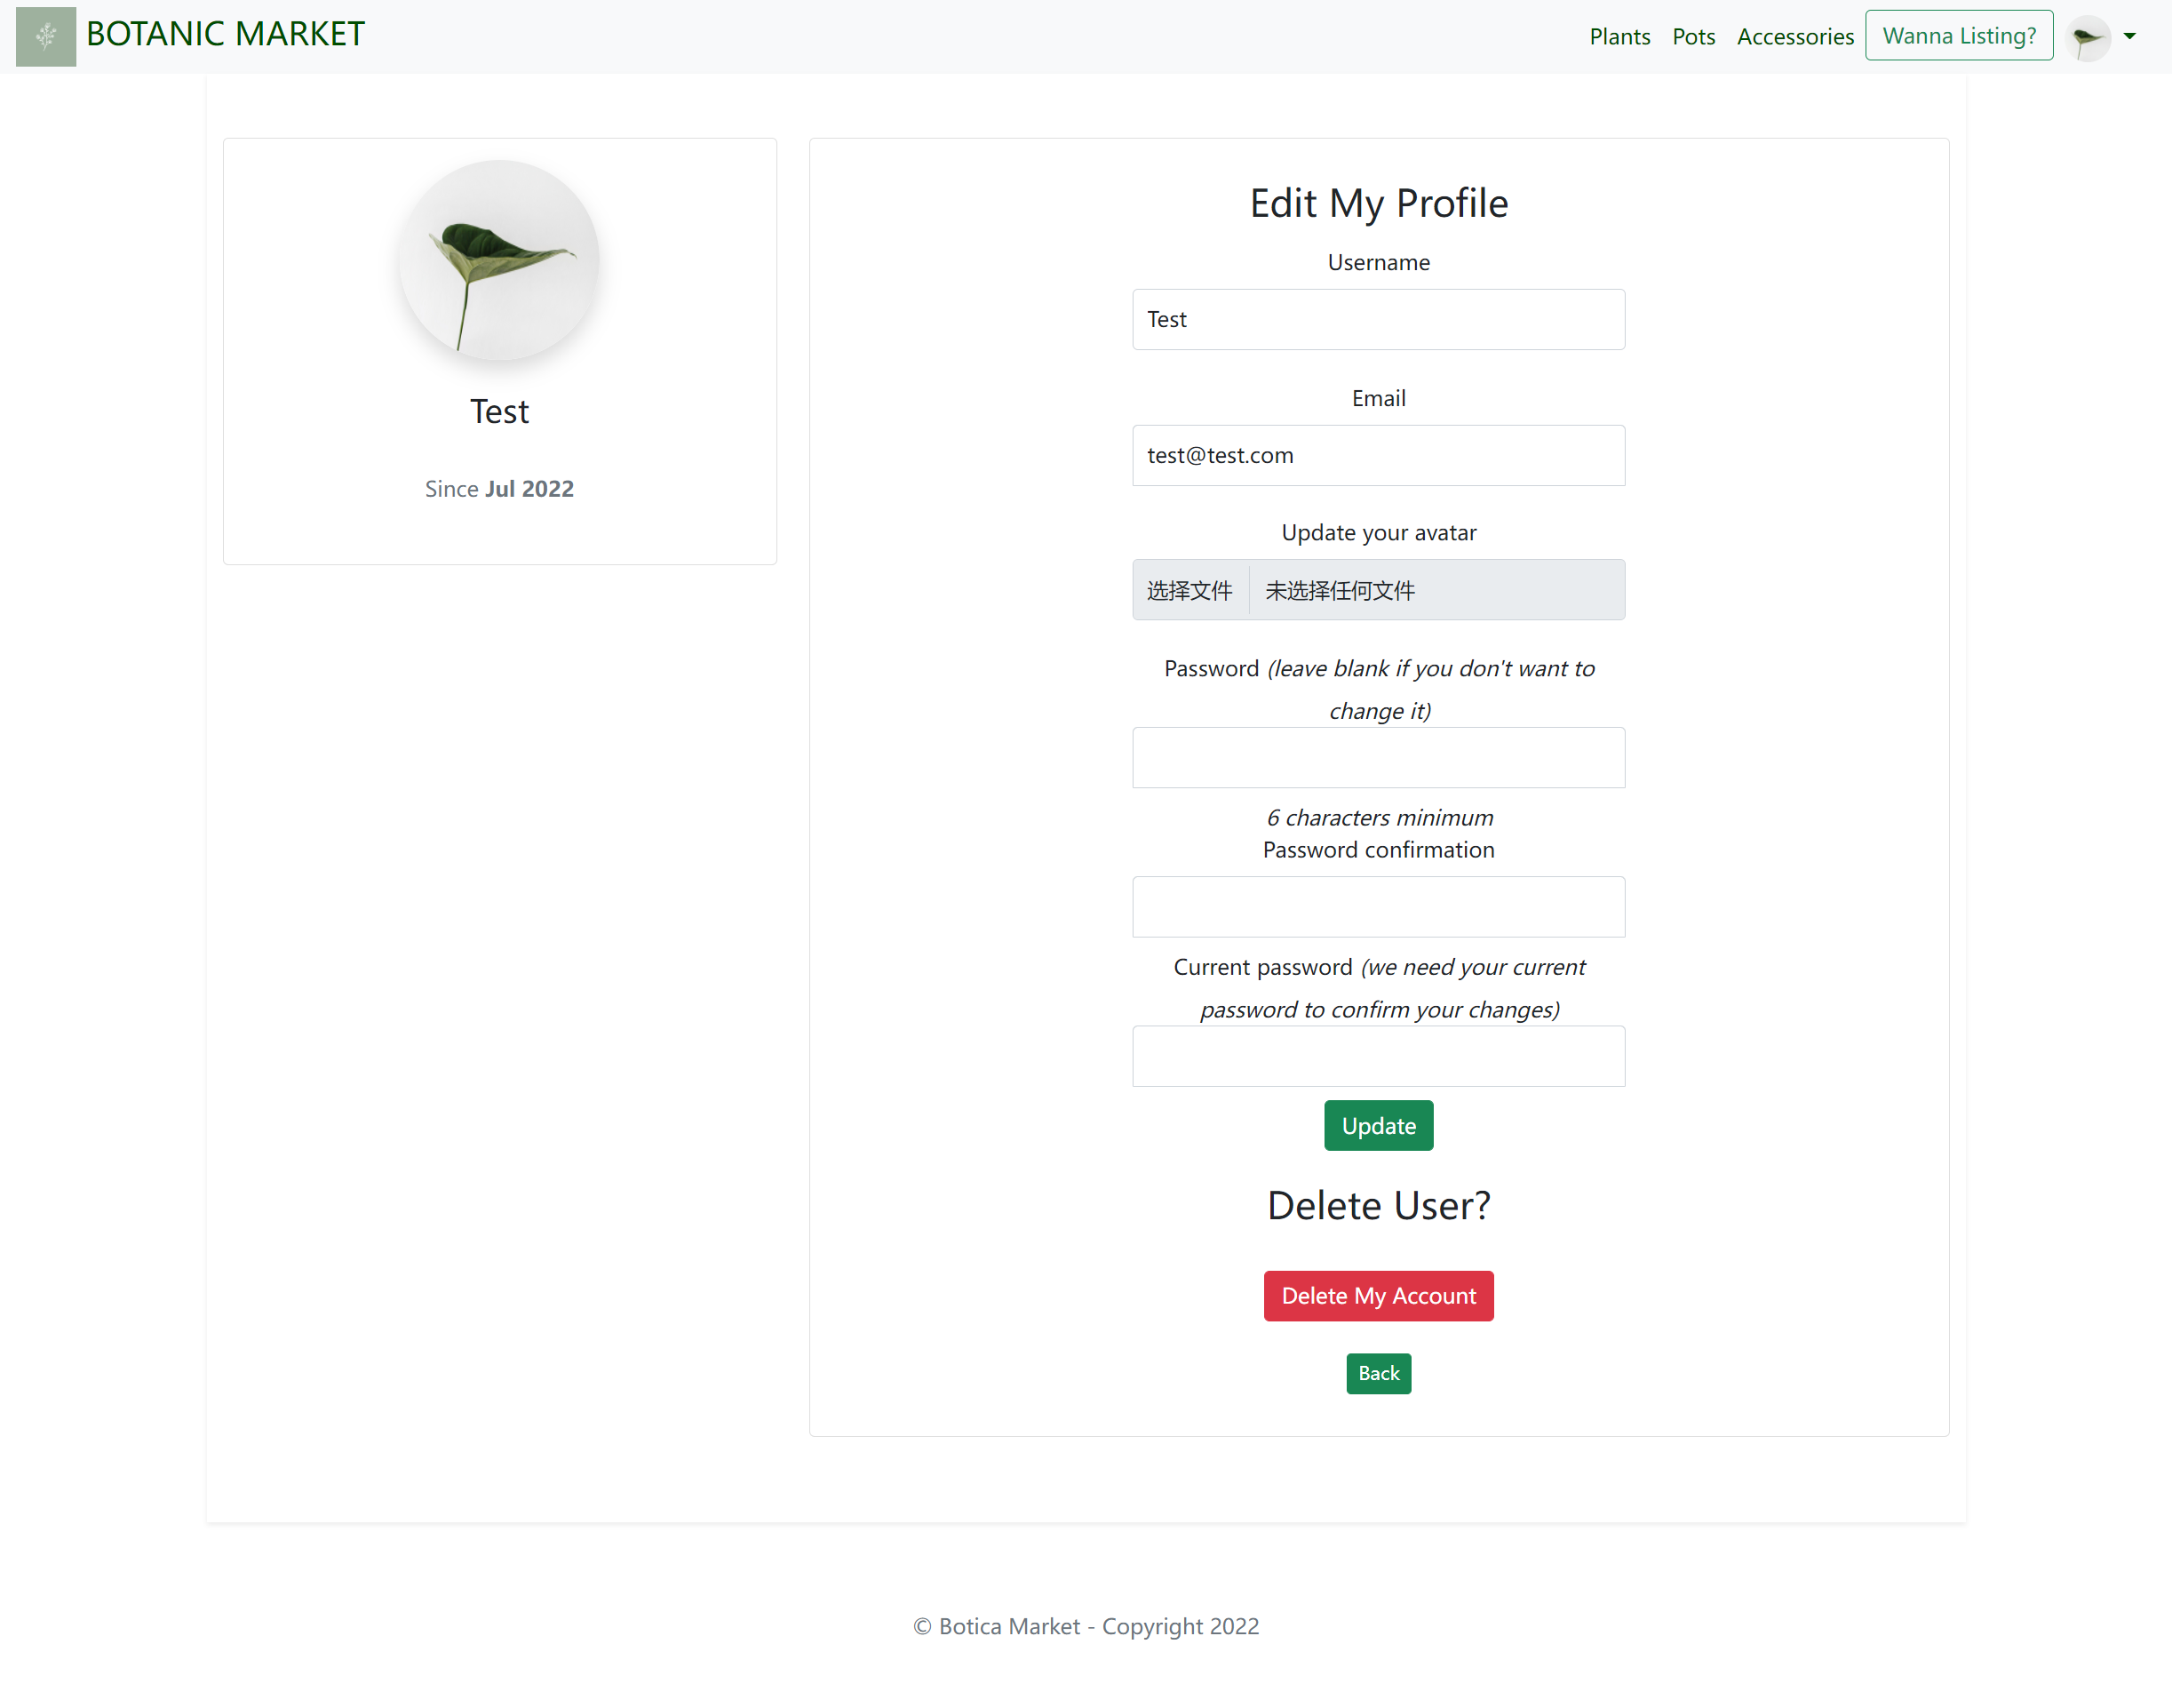
Edit Page

Slide 11
Tech Stack
CSS-bootstrap
Third Party Services
byebug (debugging tool)
devise (Used for User Authentication)
minimagick (transform images that they're uploading)
font-awesome-sass
Heroku(deploy platform)
Pg-search (for search purpose)

Slide 12
Walkthrough

Slide 13
THE END
Any Questions?

